Slide 1


GitHub Repository https://github.com/MLDB2020/MLDB

Slide 2
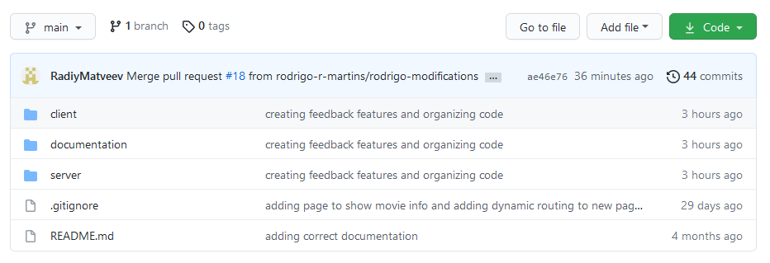
Root

Slide 3
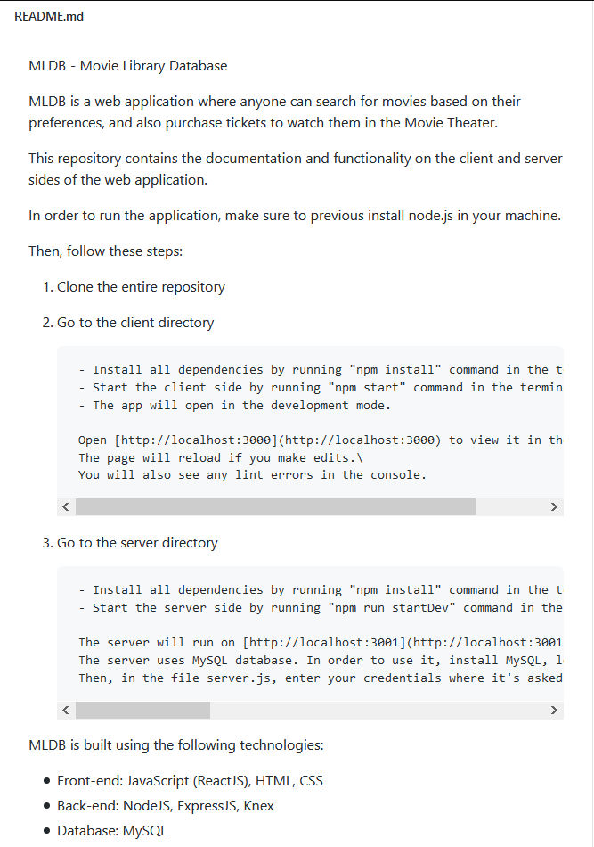
Readme (Build/Deployment Procedures)

Slide 4
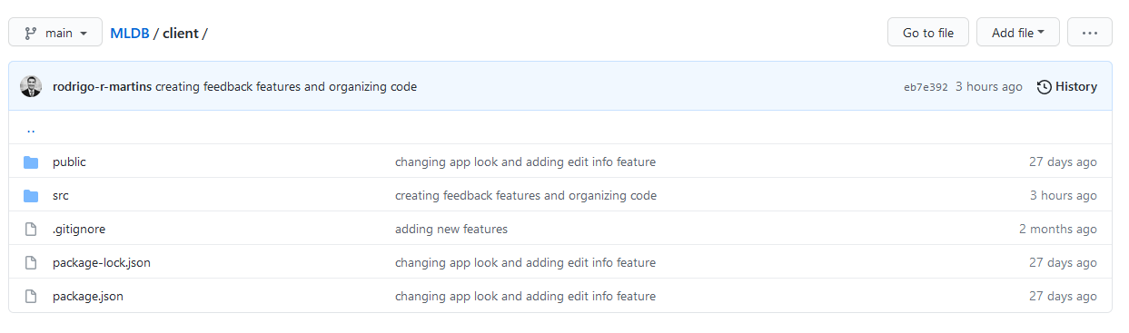
Client folder

Slide 5
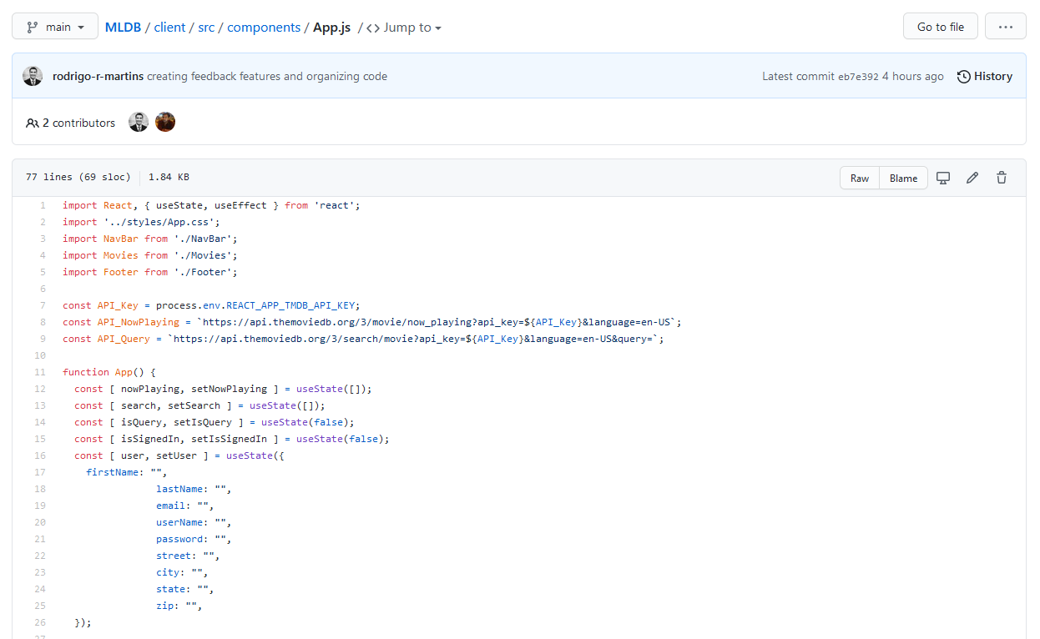
Client – Code Overview

Slide 6
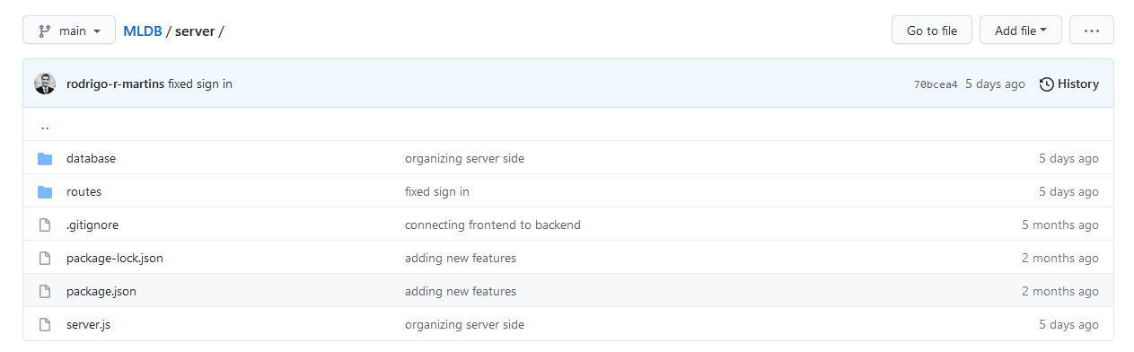
Server folder

Slide 7
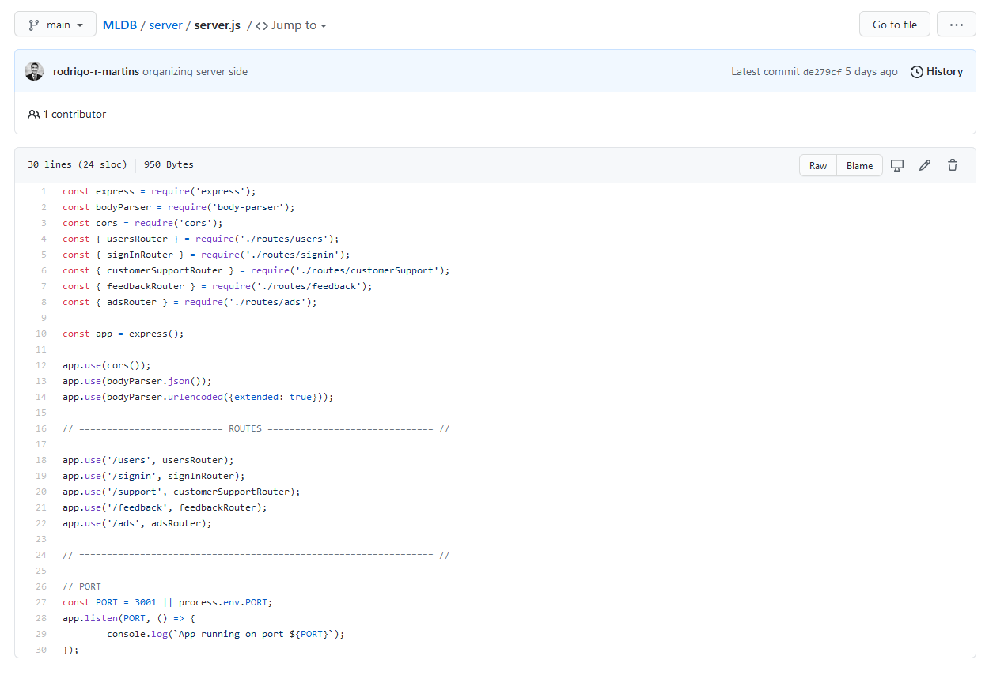
Server – Code Overview

Slide 8
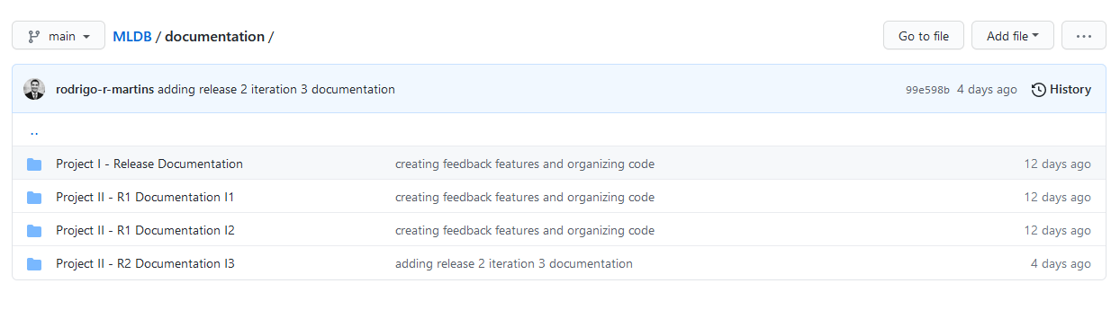
Documentation folder

Slide 9

Release 1
== Iteration 1 ==
01.01. Content Variability
04.03. Modify General User’s Information
== Iteration 2 ==
02.02. Ticket Sales
04.04. Contact Customer Support
Release 2
== Iteration 3 ==
03.02. User Relationship
== Iteration 4 ==
02.01. Ad Contents
04.05. Delete an Account

Slide 10
RELEASE 1
Sample Code and Documentation

Slide 11
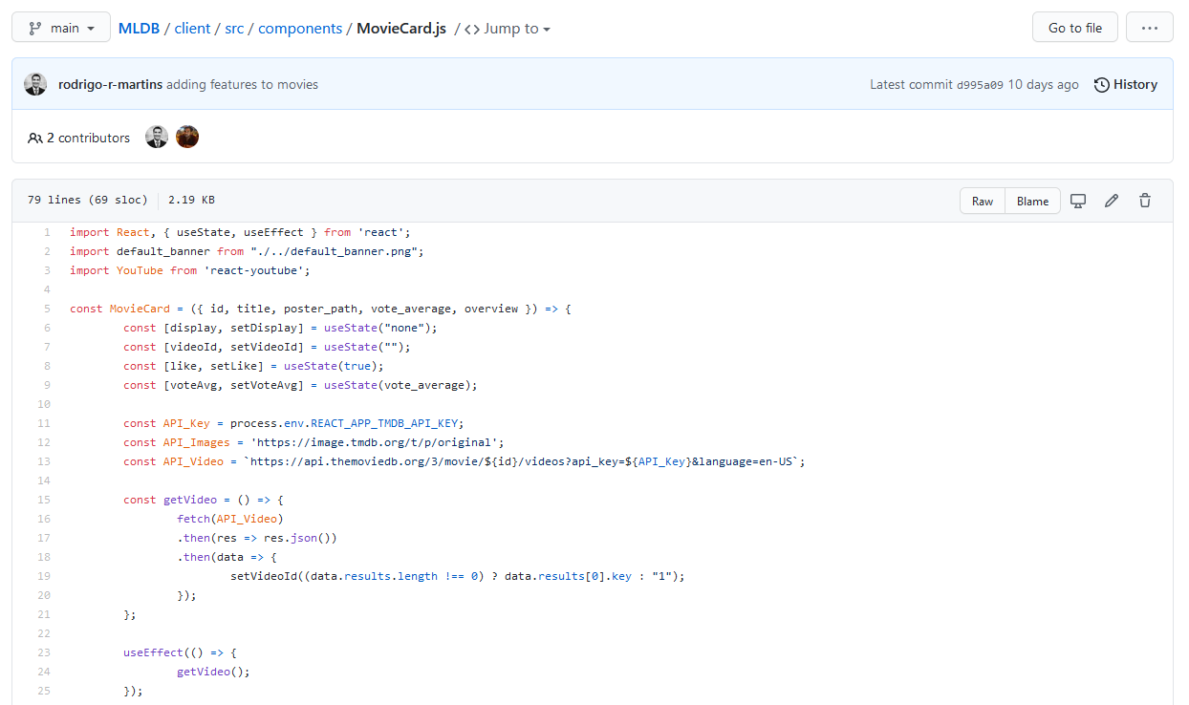
SAMPLE CODE:
=== Iteration 1 ===
01.01. Content Variability

Slide 12
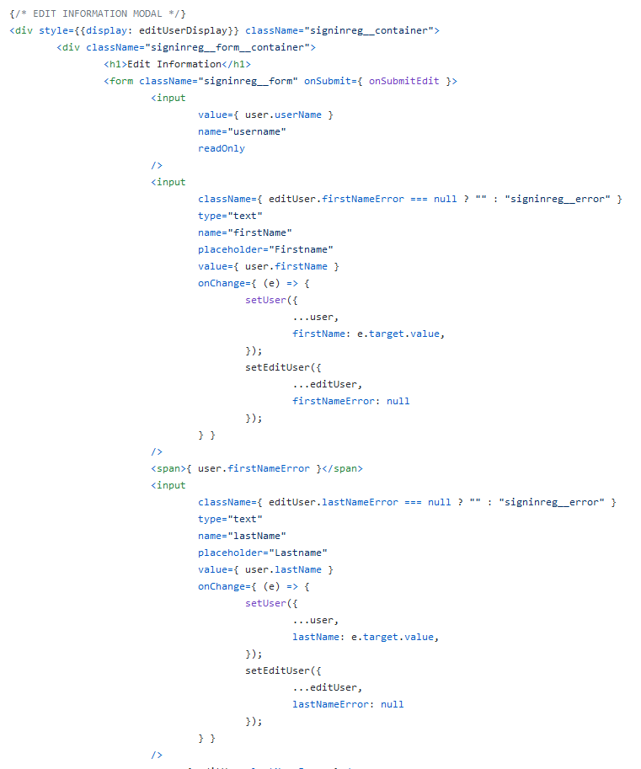
SAMPLE CODE:
=== Iteration 1 ===
04.03. Modify General User’s Information

Slide 13
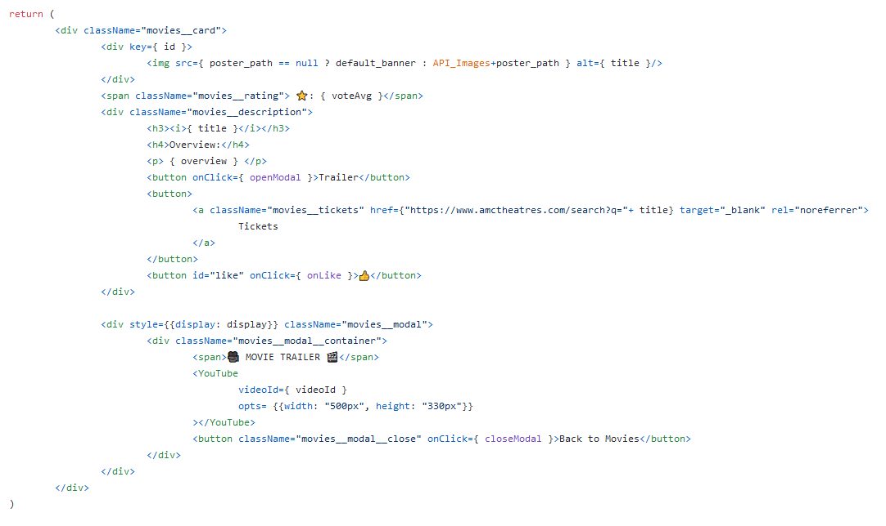
SAMPLE CODE: === Iteration 2 === 02.02. Ticket Sales

Slide 14
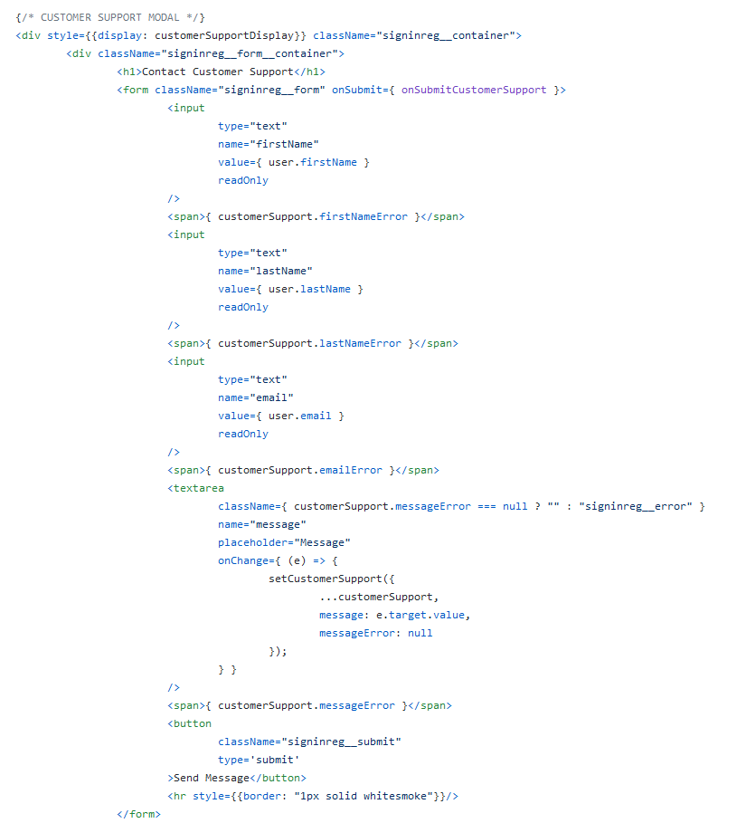
SAMPLE CODE: === Iteration 2 === 04.04. Contact Customer Support

Slide 15
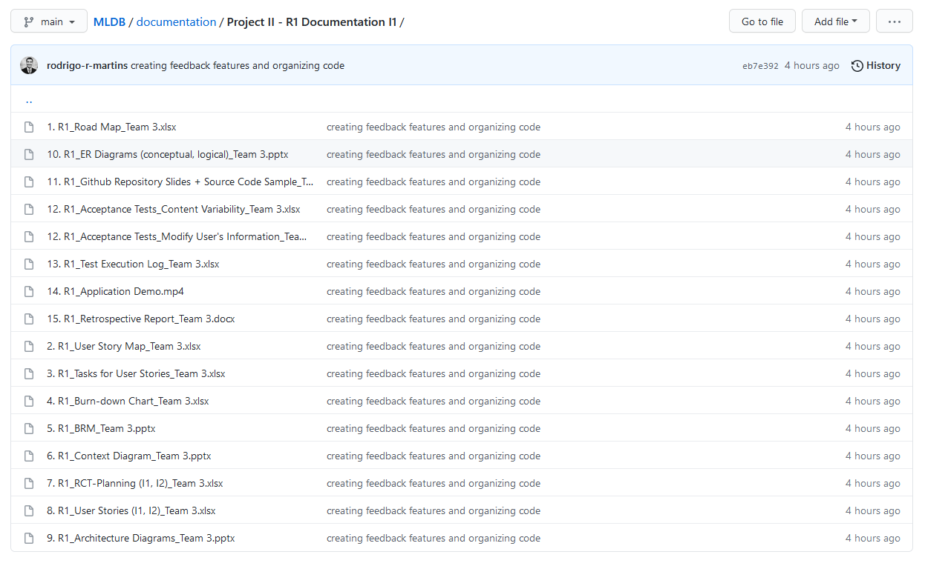
DOCUMENTATION: === Iteration 1 ===

Slide 16
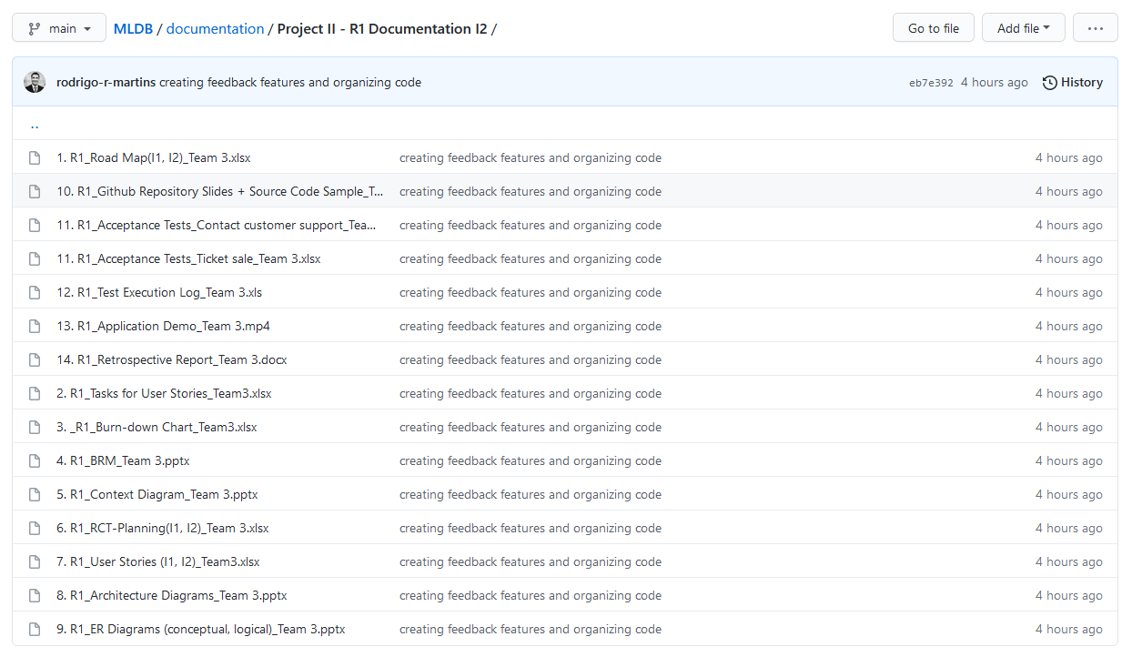
DOCUMENTATION: === Iteration 2 ===

Slide 17
RELEASE 2
Sample Code and Documentation

Slide 18
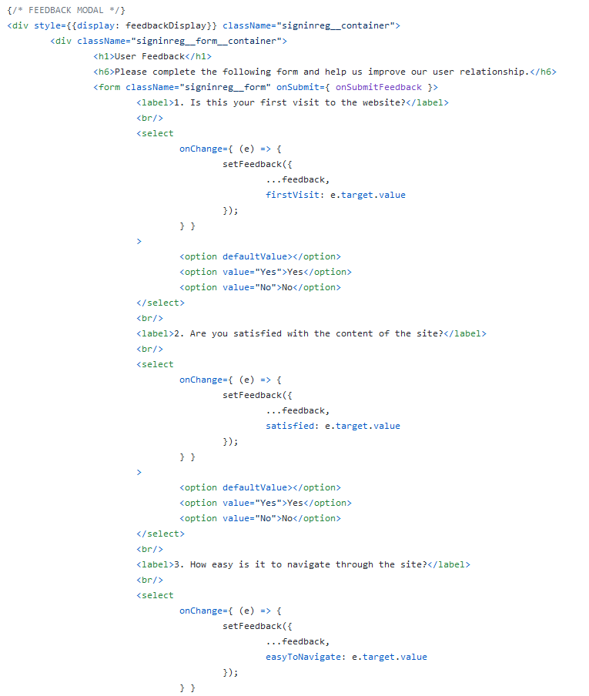
SAMPLE CODE:
=== Iteration 3 ===
03.02. User Relationship

Slide 19
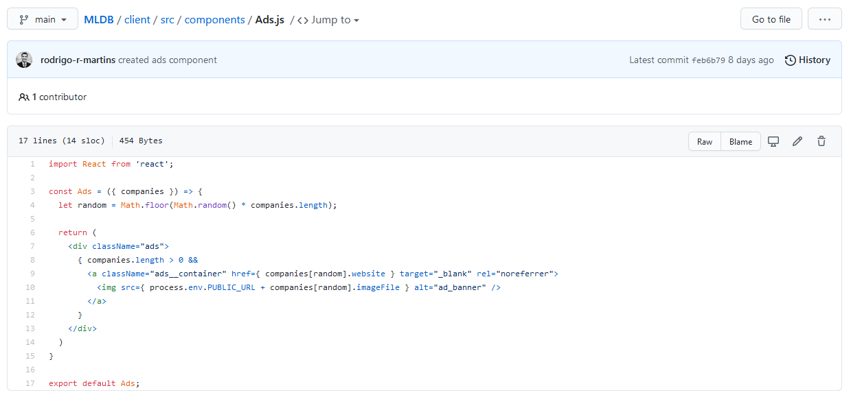
SAMPLE CODE:
=== Iteration 4 ===
02.01. Ad Contents

Slide 20
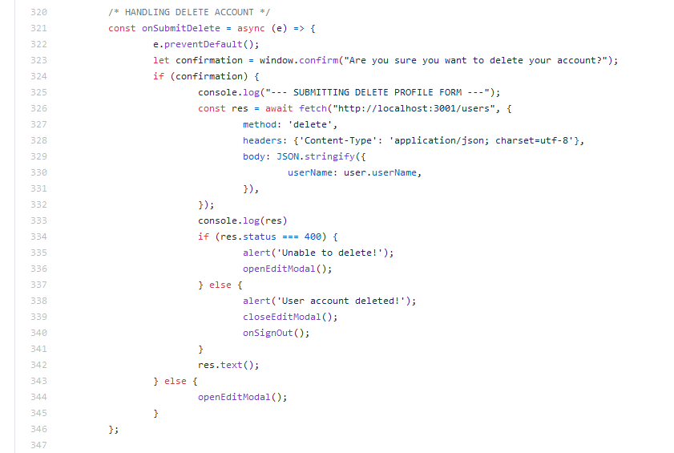
SAMPLE CODE:
=== Iteration 4 ===
04.05. Delete an Account

Slide 21
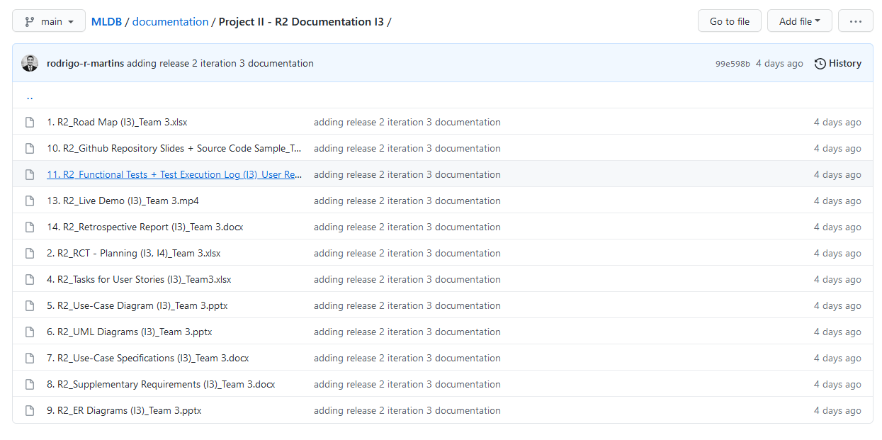
DOCUMENTATION: === Iteration 3 ===

Slide 22
DOCUMENTATION: === Iteration 4 ===
We’re still working in these documents…
As soon as we finish them, I’ll include the screenshot of the GitHub folder…

Slide 23
Thank you!

